Slide 1
Lecture 10
Groups

Slide 2
Announcements

Slide 3
Project 1: World Progress
Video: https://www.gapminder.org/videos/dont-panic-the-facts-about-population/

Slide 4
Example: Prediction

Slide 5
Apply with Multiple Columns

Slide 6
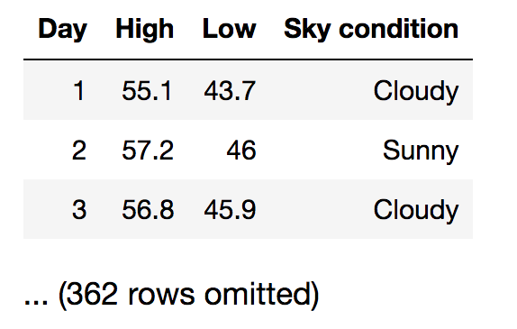
From last time: discussion Q
You have data about daily temperatures as shown. Which type of chart would you use to answer each question?
Are there more cloudy than sunny days?
What percentage of days have a high above 72º?
Did many days have a difference of more than 20 degrees between their high & low temperatures?

Slide 7
Apply
The apply method creates an array by calling a function on every element in one or more input columns
First argument: Function to apply
Other arguments: The input column(s)
table_name.apply(one_arg_function, 'column_label')
table_name.apply(two_arg_function,
'column_label_for_first_arg',
'column_label_for_second_arg')
apply called with only a function applies it to each row
(Demo)

Slide 8
Grouping by One Attribute

Slide 9
Grouping by One Column
The group method aggregates all rows with the same value for a column into a single row in the resulting table.
First argument: Which column to group by
Second argument: (Optional) How to combine values
len — number of grouped values (default)
list — list of all grouped values
sum — total of all grouped values
(Demo)

Slide 10
Cross-Classification

Slide 11
Grouping By Multiple Columns
The group method can also aggregate all rows that share the combination of values in multiple columns
First argument: A list of which columns to group by
Second argument: (Optional) How to combine values
(Demo)

Slide 12
Pivot Tables

Slide 13
Pivot
Cross-classifies according to two categorical variables
Produces a grid of counts or aggregated values
Two required arguments:
First: variable that forms column labels of grid
Second: variable that forms row labels of grid
Two optional arguments (include both or neither)
values=’column_label_to_aggregate’
collect=function_to_aggregate_with
(Demo)

Slide 14
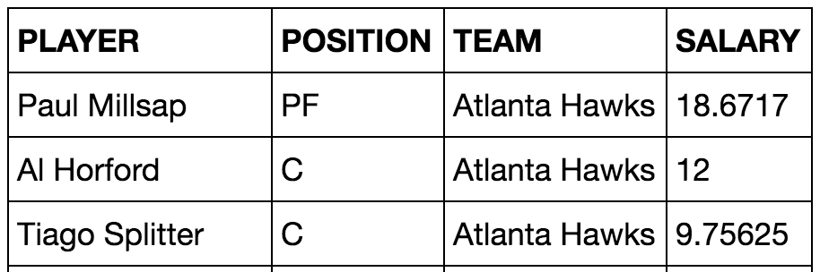
Challenge Question
Which NBA teams spent the most on their “starters” in 2015-2016?
Assume the “starter” for a team & position is the player with the highest salary on that team in that position.
(Demo)

Slide 15
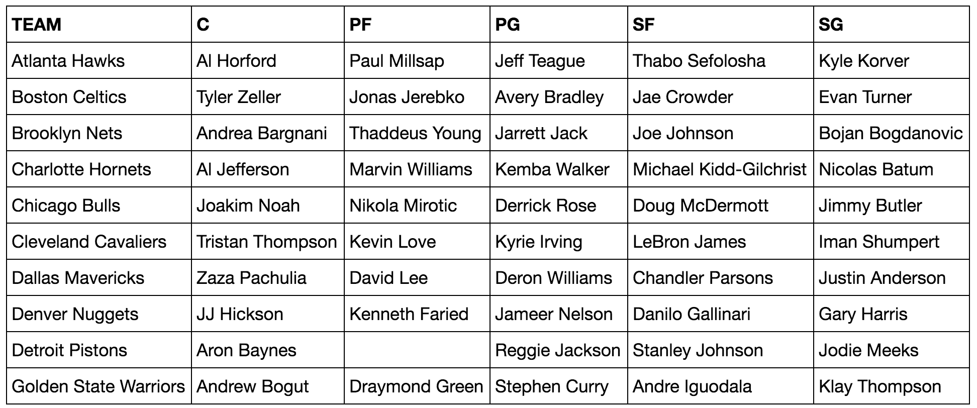
Take-Home Question
Generate a table of the names of the starters for each team

